Slide 1
Understanding DMSREJ – A “How To” Guide

Slide 2
DMSREJ Analysis – Current Approach and WCO Pointer Structure
Principles and Assumptions:
Schema is aligned to: WCO v3.6
Multiple pointers are returned across multiple Error objects using WCO IDs and no explicit link.
No explicit link between pointers - Software has to infer that where a given Error code is encountered, the next Error object contains the related pointer for that same validation failure.
Additional guidance has been provided by CDS to describe the number of expected pointers per error code.
N.B. If error is related to D.E. 2/3 Document Type and D.E. 2/6 Deferred Payment, then an additional error block will be received due to concatenated fields. This means where two pointers are usually returned, then three will be sent.
<Error>
<ValidationCode>CDS12056</ValidationCode>
<Pointer>
<DocumentSectionCode>42A</DocumentSectionCode>
</Pointer>
<Pointer>
<SequenceNumeric>1</SequenceNumeric>
<DocumentSectionCode>67A</DocumentSectionCode>
</Pointer>
<Pointer>
<SequenceNumeric>1</SequenceNumeric>
<DocumentSectionCode>68A</DocumentSectionCode>
</Pointer>
<Pointer>
<SequenceNumeric>3</SequenceNumeric>
<DocumentSectionCode>02A</DocumentSectionCode>
<TagID>D006</TagID>
</Pointer>
</Error>
<Error>
<ValidationCode>CDS12056</ValidationCode>
<Pointer>
<DocumentSectionCode>42A</DocumentSectionCode>
</Pointer>
<Pointer>
<SequenceNumeric>1</SequenceNumeric>
<DocumentSectionCode>67A</DocumentSectionCode>
</Pointer>
<Pointer>
<SequenceNumeric>1</SequenceNumeric>
<DocumentSectionCode>68A</DocumentSectionCode>
</Pointer>
<Pointer>
<SequenceNumeric>3</SequenceNumeric>
<DocumentSectionCode>02A</DocumentSectionCode>
<TagID>D031</TagID>
</Pointer>
</Error>
Protective Marking - <EXTERNAL> |
2
14/01/2020 |

Slide 3
DMSREJ Analysis – Understanding the XML Elements
Validation Code:
  The <ValidationCode> XML element captures the error code thrown identifying the error. The error code can be mapped to an error message.
Pointer:
  The <Pointer> XML elements are used to locate the specific WCO element that has triggered the rejection of a declaration.
Tag ID:
  Once a WCO element has been identified, a <TagID> XML Element may be used to further specify the data element that has caused the rejection of the declaration.
Sequence Numeric:
  Where a declaration may have multiple instances of an item that a pointer could refer to (e.g. second entry in D.E. 2/3 (Documents)), the <SequenceNumeric> XML Element may be used to identify which specific instance has caused the declaration to be rejected.
  Where a specific instance can not be identified as the offending item, a sequence numeric will not be returned.
<Error>
<ValidationCode>CDS12056</ValidationCode>
<Pointer>
<DocumentSectionCode>42A</DocumentSectionCode>
</Pointer>
<Pointer>
<SequenceNumeric>1</SequenceNumeric>
<DocumentSectionCode>67A</DocumentSectionCode>
</Pointer>
<Pointer>
<SequenceNumeric>1</SequenceNumeric>
<DocumentSectionCode>68A</DocumentSectionCode>
</Pointer>
<Pointer>
<SequenceNumeric>3</SequenceNumeric>
<DocumentSectionCode>02A</DocumentSectionCode>
<TagID>D006</TagID>
</Pointer>
</Error>
<Error>
<ValidationCode>CDS12056</ValidationCode>
<Pointer>
<DocumentSectionCode>42A</DocumentSectionCode>
</Pointer>
<Pointer>
<SequenceNumeric>1</SequenceNumeric>
<DocumentSectionCode>67A</DocumentSectionCode>
</Pointer>
<Pointer>
<SequenceNumeric>1</SequenceNumeric>
<DocumentSectionCode>68A</DocumentSectionCode>
</Pointer>
<Pointer>
<SequenceNumeric>3</SequenceNumeric>
<DocumentSectionCode>02A</DocumentSectionCode>
<TagID>D031</TagID>
</Pointer>
</Error>
Protective Marking - <EXTERNAL> |
3
14/01/2020 |

Slide 4
Example 1 – One Pointer

Slide 5
DMSREJ XML
<soap:Envelope xmlns:soap="http://schemas.xmlsoap.org/soap/envelope/">
<soap:Header>
<v1:dmsGatewayHeader xmlns:v1="http://ecf.dms.core/gatewayHeader/v1/">
<communicationAddress>hmrcgwid:a000a0aa-aaa0-00a0-…-0aa0-0000a0a00000</communicationAddress>
<messageType>WCOTN</messageType>
</v1:dmsGatewayHeader>
</soap:Header>
<soap:Body>
<v3:notifyTrader xmlns:_2="urn:wco:datamodel:WCO:DocumentMetaData-DMS:2"xmlns:_2_1="urn:wco:datamodel:WCO:RES-DMS:2"xmlns:_2_2="urn:wco:datamodel:WCO:Response_DS:DMS:2"xmlns:v3="http://core.dms/.../v3/">
<_2:MetaData>
<_2:WCODataModelVersionCode>3.6</_2:WCODataModelVersionCode>
<_2:WCOTypeName>RES</_2:WCOTypeName>
<_2:ResponsibleCountryCode/>
<_2:ResponsibleAgencyName/>
<_2:AgencyAssignedCustomizationCode/>
<_2:AgencyAssignedCustomizationVersionCode/>
<_2_1:Response>
<_2_1:FunctionCode>03</_2_1:FunctionCode>
<_2_1:FunctionalReferenceID>fc34cb18eefe4ddcbf07456b4d1a12a4</_2_1:FunctionalReferenceID>
<_2_1:IssueDateTime>
<_2_2:DateTimeString formatCode="304">20191107115245Z</_2_2:DateTimeString>
</_2_1:IssueDateTime>
<_2_1:Error>
<_2_1:ValidationCode>CDS71252</_2_1:ValidationCode>
<_2_1:Pointer>
<_2_1:DocumentSectionCode>42A</_2_1:DocumentSectionCode>
</_2_1:Pointer>
<_2_1:Pointer>
<_2_1:DocumentSectionCode>67A</_2_1:DocumentSectionCode>
</_2_1:Pointer>
<_2_1:Pointer>
<_2_1:SequenceNumeric>1</_2_1:SequenceNumeric>
<_2_1:DocumentSectionCode>68A</_2_1:DocumentSectionCode>
</_2_1:Pointer>
<_2_1:Pointer>
<_2_1:DocumentSectionCode>92A</_2_1:DocumentSectionCode>
<_2_1:TagID>063</_2_1:TagID>
</_2_1:Pointer>
</_2_1:Error>
<_2_1:Declaration>
<_2_1:FunctionalReferenceID> KM_20191107111111</_2_1:FunctionalReferenceID>
<_2_1:ID>19GBAAAAAAAAAAAAA0</_2_1:ID>
<_2_1:RejectionDateTime>
<_2_2:DateTimeString formatCode="304">20191107115245Z</_2_2:DateTimeString>
</_2_1:RejectionDateTime>
<_2_1:VersionID>1</_2_1:VersionID>
</_2_1:Declaration></2_1:Response></_2:MetaData></v3:notifyTrader></soap:Body></soap:Envelope>
Protective Marking - <EXTERNAL> |
5
14/01/2020 |

Slide 6
DMSREJ XML – Focus on the Error XML Blocks
<_2_1:Error>
<_2_1:ValidationCode>CDS71252</_2_1:ValidationCode>
<_2_1:Pointer>
<_2_1:DocumentSectionCode>42A</_2_1:DocumentSectionCode>
</_2_1:Pointer>
<_2_1:Pointer>
<_2_1:DocumentSectionCode>67A</_2_1:DocumentSectionCode>
</_2_1:Pointer>
<_2_1:Pointer>
<_2_1:SequenceNumeric>1</_2_1:SequenceNumeric>
<_2_1:DocumentSectionCode>68A</_2_1:DocumentSectionCode>
</_2_1:Pointer>
<_2_1:Pointer>
<_2_1:DocumentSectionCode>92A</_2_1:DocumentSectionCode>
<_2_1:TagID>063</_2_1:TagID>
</_2_1:Pointer>
</_2_1:Error>
<_2_1:Declaration>
<_2_1:FunctionalReferenceID>KM_20191107111111</_2_1:FunctionalReferenceID>
<_2_1:ID>19GBAAAAAAAAAAAAA0</_2_1:ID>
<_2_1:RejectionDateTime>
<_2_2:DateTimeString formatCode="304">…000A</_2_2:DateTimeString>
</_2_1:RejectionDateTime>
<_2_1:VersionID>1</_2_1:VersionID>
</_2_1:Declaration>
Protective Marking - <EXTERNAL> |
6
14/01/2020 |

Slide 7
DMSREJ XML – Understanding What’s Left
<_2_1:Error>
<_2_1:ValidationCode>CDS71252</_2_1:ValidationCode>
<_2_1:Pointer>
<_2_1:DocumentSectionCode>42A</_2_1:DocumentSectionCode>
</_2_1:Pointer>
<_2_1:Pointer>
<_2_1:DocumentSectionCode>67A</_2_1:DocumentSectionCode>
</_2_1:Pointer>
<_2_1:Pointer>
<_2_1:SequenceNumeric>1</_2_1:SequenceNumeric>
<_2_1:DocumentSectionCode>68A</_2_1:DocumentSectionCode>
</_2_1:Pointer>
<_2_1:Pointer>
<_2_1:DocumentSectionCode>92A</_2_1:DocumentSectionCode>
<_2_1:TagID>063</_2_1:TagID>
</_2_1:Pointer>
</_2_1:Error>
<_2_1:Declaration>
<_2_1:FunctionalReferenceID>KM_20191107111111</_2_1:FunctionalReferenceID>
<_2_1:ID>19GBAAAAAAAAAAAAA0</_2_1:ID>
<_2_1:RejectionDateTime>
<_2_2:DateTimeString formatCode="304">…000A</_2_2:DateTimeString>
</_2_1:RejectionDateTime>
<_2_1:VersionID>1</_2_1:VersionID>
</_2_1:Declaration>
Error Code: Describes what Error has been thrown
Pointer
Pointer: Narrows down to the WCO Element causing the error to be thrown
Error Block
Sequence Numeric: (Where a list exists) identifies offending instance of the list.
Tag ID: Narrows down to the WCO Element causing the error to be thrown
Please refer to “CDS Codelists and WCO References v1.41” to translate DocumentSectionCode & TagID
Note: The error codes used in this page may not yet be available in Trade Test or Production.
Protective Marking - <EXTERNAL> |
7
14/01/2020 |

Slide 8
DMSREJ XML – Understanding What’s Left – Refer to WCO.
<_2_1:Error>
<_2_1:ValidationCode>CDS71252</_2_1:ValidationCode>
<_2_1:Pointer>
<_2_1:DocumentSectionCode>42A</_2_1:DocumentSectionCode>
</_2_1:Pointer>
<_2_1:Pointer>
<_2_1:DocumentSectionCode>67A</_2_1:DocumentSectionCode>
</_2_1:Pointer>
<_2_1:Pointer>
<_2_1:SequenceNumeric>1</_2_1:SequenceNumeric>
<_2_1:DocumentSectionCode>68A</_2_1:DocumentSectionCode>
</_2_1:Pointer>
<_2_1:Pointer>
<_2_1:DocumentSectionCode>92A</_2_1:DocumentSectionCode>
<_2_1:TagID>063</_2_1:TagID>
</_2_1:Pointer>
</_2_1:Error>
<_2_1:Declaration>
<_2_1:FunctionalReferenceID>KM_20191107111111</_2_1:FunctionalReferenceID>
<_2_1:ID>19GBAAAAAAAAAAAAA0</_2_1:ID>
<_2_1:RejectionDateTime>
<_2_2:DateTimeString formatCode="304">…000A</_2_2:DateTimeString>
</_2_1:RejectionDateTime>
<_2_1:VersionID>1</_2_1:VersionID>
</_2_1:Declaration>
CDS71252: Licence not valid for declared Country of Origin
Pointer
42A: Declaration
62A: Goods Shipment
Error Block
68A: 1st Government Agency Goods Item
92A: Origin
063: Country Code
This DMSREJ tells us that the Country Code for the Origin on the declaration of the first goods item on the declaration is not a valid Country Code.
Note: The error codes used in this page are not yet be available in Trade Test or Production.
Protective Marking - <EXTERNAL> |
8
14/01/2020 |

Slide 9
Resolving the Issue for this Example
The Error Message is: Licence not valid for declared Country of Origin.
The pointer points to:
  The Country of Origin on the 1st goods item (D.E. 5/15).
D.E. 5/15 on the first goods item is “NZ”.
Allowed Countries on the licence is “JP”.
With this information, we now know that the licence is not valid for the Country of Origin.
Therefore, we either need to use a different licence where Allowed Countries include “NZ” or submit a declaration for the goods where the Country of Origin is “JP”.
Protective Marking - <EXTERNAL> |
9
14/01/2020 |

Slide 10
Example 2 – Two Pointer

Slide 11
DMSREJ XML (Error Blocks Only)
<_2_1:Error>
<_2_1:ValidationCode>DMS12070</_2_1:ValidationCode>
<_2_1:Pointer>
<_2_1:DocumentSectionCode>42A</_2_1:DocumentSectionCode>
</_2_1:Pointer>
<_2_1:Pointer>
<_2_1:DocumentSectionCode>67A</_2_1:DocumentSectionCode>
</_2_1:Pointer>
<_2_1:Pointer>
<_2_1:SequenceNumeric>1</_2_1:SequenceNumeric>
<_2_1:DocumentSectionCode>68A</_2_1:DocumentSectionCode>
</_2_1:Pointer>
<_2_1:Pointer>
<_2_1:SequenceNumeric>6</_2_1:SequenceNumeric>
<_2_1:DocumentSectionCode>02A</_2_1:DocumentSectionCode>
<_2_1:TagID>360</_2_1:TagID>
</_2_1:Pointer>
</_2_1:Error>
<_2_1:Error>
<_2_1:ValidationCode>DMS12070</_2_1:ValidationCode>
<_2_1:Pointer>
<_2_1:DocumentSectionCode>42A</_2_1:DocumentSectionCode>
</_2_1:Pointer>
<_2_1:Pointer>
<_2_1:DocumentSectionCode>67A</_2_1:DocumentSectionCode>
</_2_1:Pointer>
<_2_1:Pointer>
<_2_1:SequenceNumeric>1</_2_1:SequenceNumeric>
<_2_1:DocumentSectionCode>68A</_2_1:DocumentSectionCode>
</_2_1:Pointer>
<_2_1:Pointer>
<_2_1:SequenceNumeric>6</_2_1:SequenceNumeric>
<_2_1:DocumentSectionCode>02A</_2_1:DocumentSectionCode>
<_2_1:TagID>D028</_2_1:TagID>
</_2_1:Pointer>
</_2_1:Error>
CDS12056: Relation error: The combination of elements is not allowed
The 2 error blocks point to:
The 6th Document Status Code for Goods Item 1 on the declaration
The 6th Document Reason for Goods Item 1 on the declaration
42A: Declaration
67A: Goods Shipment
68A: 1st Government Agency Goods Item
02A-360: The Document Status Code of the sixth entry in D.E. 2/3
Note: The error codes used in this page are not yet be available in Trade Test or Production.
CDS12056: Relation error: The combination of elements is not allowed
42A: Declaration
67A: Goods Shipment
68A: 1st Government Agency Goods Item
02A-D028: The Document Reason of the sixth entry in D.E. 2/3
Protective Marking - <EXTERNAL> |
11
14/01/2020 |

Slide 12
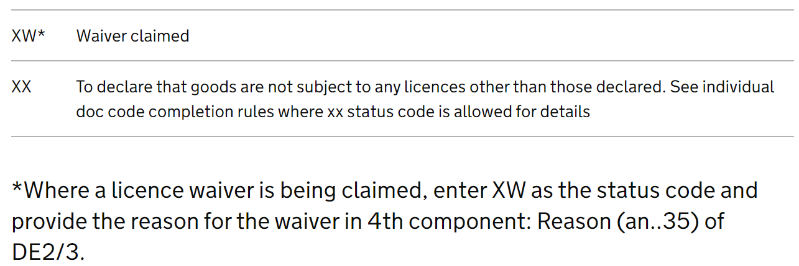
Resolving The Issue
The Error Message is: Relation Error: The value supplied in Data Element 1 mandates the completion of Data Element 2.
The pointers point to:
  The 6th Document Code on the 1st goods item (D.E. 2/3).
  The 6th Document Reason on the 1st goods item (D.E. 2/3).
The declaration was completed as follows:
  The 6th Document Status Code on the first goods item on the declaration is: “XY”
  The 6th Document Reason on the first goods item on the declaration is : Null
Looking at the guidance on the Paper Tariff:
The Paper Tariff confirms that Document Status Code “XW” mandates a Reason be provided.
To resolve this issue, we must provide a Reason when using Document Status Code “XW”.
Protective Marking - <EXTERNAL> |
12
14/01/2020 |

Slide 13
Example 3 – Two Pointer

Slide 14
DMSREJ XML (Error Blocks Only)
<_2_1:Error>
<_2_1:ValidationCode>CDS12119</_2_1:ValidationCode>
<_2_1:Pointer>
<_2_1:DocumentSectionCode>42A</_2_1:DocumentSectionCode>
</_2_1:Pointer>
<_2_1:Pointer>
<_2_1:DocumentSectionCode>67A</_2_1:DocumentSectionCode>
</_2_1:Pointer>
<_2_1:Pointer>
<_2_1:SequenceNumeric>1</_2_1:SequenceNumeric>
<_2_1:DocumentSectionCode>68A</_2_1:DocumentSectionCode>
</_2_1:Pointer>
<_2_1:Pointer>
<_2_1:DocumentSectionCode>70A</_2_1:DocumentSectionCode>
<_2_1:TagID>161</_2_1:TagID>
</_2_1:Pointer>
</_2_1:Error>
<_2_1:Error>
<_2_1:ValidationCode>CDS12056</_2_1:ValidationCode>
<_2_1:Pointer>
<_2_1:DocumentSectionCode>42A</_2_1:DocumentSectionCode>
</_2_1:Pointer>
<_2_1:Pointer>
<_2_1:DocumentSectionCode>67A</_2_1:DocumentSectionCode>
</_2_1:Pointer>
<_2_1:Pointer>
<_2_1:SequenceNumeric>2</_2_1:SequenceNumeric>
<_2_1:DocumentSectionCode>99A</_2_1:DocumentSectionCode>
<_2_1:TagID>D019</_2_1:TagID>
</_2_1:Pointer>
</_2_1:Error>
CDS12119: Relation Error: Declared Additional Document (D.E. 2/3) is not allowed with this Procedure Code (D.E. 1/10 or D.E. 1/11)
The 2 error blocks point to:
Pervious Procedure Code for Goods Item 1 on the declaration
The 2nd Previous Document Code on the declaration
42A: Declaration
67A: Goods Shipment
68A: 1st Government Agency Goods Item
Note: The error codes used in this page are not yet be available in Trade Test or Production.
70A-161: The Previous Procedure Code in D.E. 1/10
CDS12056: Relation error: The combination of
elements is not allowed
42A: Declaration
67A: Goods Shipment
99A-D019: The 2nd Previous Document Code in D.E. 2/1
Protective Marking - <EXTERNAL> |
14
14/01/2020 |

Slide 15
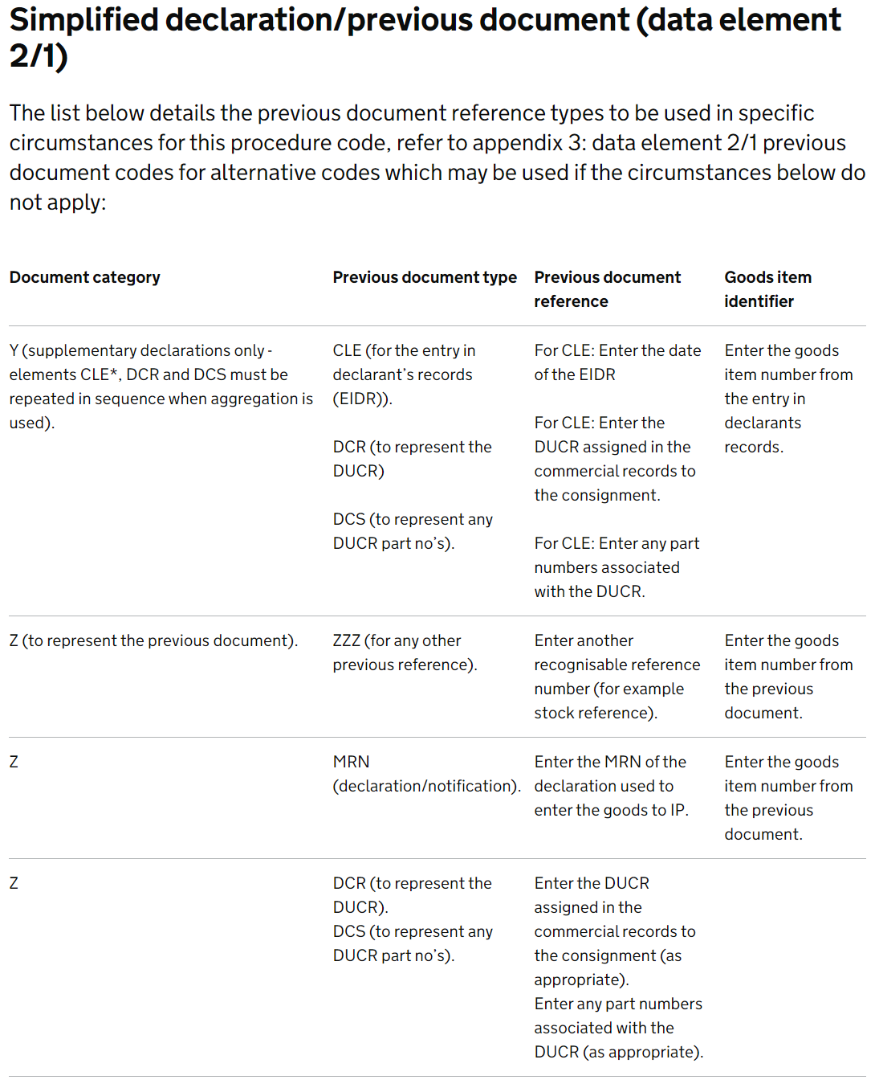
Resolving The Issue
The Error Message is: Relation Error: Declared Additional Document (D.E. 2/3) is not allowed with this Procedure Code (D.E. 1/10 or D.E. 1/11).
The pointers point to:
  The Previous Procedure Code on the 1st goods item (D.E. 1/10).
  The 2nd Previous Document Code on the declaration (D.E. 2/1).
The declaration was completed as follows:
  The Procedure Code for the 1st goods item of the declaration is: “4051”
    The Previous Procedure Code is “51”
  The 2nd Previous Document Code on this declaration is : “X337”
Looking at the guidance on the Paper Tariff:
The Paper Tariff confirms that Previous Document Code “X337” is not a valid Previous Document Code for Procedure Code 4051.
To resolve this issue, we can remove the Previous Document Status Code “X337”.
Protective Marking - <EXTERNAL> |
15
14/01/2020 |

Slide 16
Example 4 – Three Pointer

Slide 17
DMSREJ XML (Error Blocks Only)
<_2_1:Error>
<_2_1:ValidationCode>CDS12056</_2_1:ValidationCode>
<_2_1:Pointer>
<_2_1:DocumentSectionCode>42A</_2_1:DocumentSectionCode>
</_2_1:Pointer>
<_2_1:Pointer>
<_2_1:DocumentSectionCode>67A</_2_1:DocumentSectionCode>
</_2_1:Pointer>
<_2_1:Pointer>
<_2_1:SequenceNumeric>1</_2_1:SequenceNumeric>
<_2_1:DocumentSectionCode>68A</_2_1:DocumentSectionCode>
</_2_1:Pointer>
<_2_1:Pointer>
<_2_1:SequenceNumeric>2</_2_1:SequenceNumeric>
<_2_1:DocumentSectionCode>02A</_2_1:DocumentSectionCode>
<_2_1:TagID>360</_2_1:TagID>
</_2_1:Pointer>
</_2_1:Error>
<_2_1:Error>
<_2_1:ValidationCode>CDS12056</_2_1:ValidationCode>
<_2_1:Pointer>
<_2_1:DocumentSectionCode>42A</_2_1:DocumentSectionCode>
</_2_1:Pointer>
<_2_1:Pointer>
<_2_1:SequenceNumeric>1</_2_1:SequenceNumeric>
<_2_1:DocumentSectionCode>67A</_2_1:DocumentSectionCode>
</_2_1:Pointer>
<_2_1:Pointer>
<_2_1:SequenceNumeric>1</_2_1:SequenceNumeric>
<_2_1:DocumentSectionCode>68A</_2_1:DocumentSectionCode>
</_2_1:Pointer>
<_2_1:Pointer>
<_2_1:SequenceNumeric>2</_2_1:SequenceNumeric>
<_2_1:DocumentSectionCode>02A</_2_1:DocumentSectionCode>
<_2_1:TagID>D006</_2_1:TagID>
</_2_1:Pointer>
</_2_1:Error>
CDS12056: Relation error: The combination of elements is not allowed
<_2_1:Error>
<_2_1:ValidationCode>DMS12056</_2_1:ValidationCode>
<_2_1:Pointer>
<_2_1:DocumentSectionCode>42A</_2_1:DocumentSectionCode>
</_2_1:Pointer>
<_2_1:Pointer>
<_2_1:SequenceNumeric>1</_2_1:SequenceNumeric>
<_2_1:DocumentSectionCode>67A</_2_1:DocumentSectionCode>
</_2_1:Pointer>
<_2_1:Pointer>
<_2_1:SequenceNumeric>1</_2_1:SequenceNumeric>
<_2_1:DocumentSectionCode>68A</_2_1:DocumentSectionCode>
</_2_1:Pointer>
<_2_1:Pointer>
<_2_1:SequenceNumeric>2</_2_1:SequenceNumeric>
<_2_1:DocumentSectionCode>02A</_2_1:DocumentSectionCode>
<_2_1:TagID>D031</_2_1:TagID>
</_2_1:Pointer>
</_2_1:Error>
CDS12056: Relation error: The combination of
elements is not allowed
42A: Declaration
42A: Declaration
67A: Goods Shipment
67A: Goods Shipment
68A: 1st Government Agency Goods Item
68A: 1st Government Agency Goods Item
02A-360: The Document Status Code of the second entry in D.E. 2/3
02A-D031: The Document Category of the second entry in D.E. 2/3
CDS12056: Relation error: The combination of elements is not allowed
42A: Declaration
67A: Goods Shipment
The 3 error blocks point to:
Document Status Code for Goods Item 2 on the declaration
Document Type for Goods Item 2 on the declaration
Document Category for Goods Item 2 on the declaration
  N.B. Document Type + Document Category = Document Code
68A: 1st Government Agency Goods Item
02A-D006: The Document Type of the second entry in D.E. 2/3
Note: The error codes used in this page are not yet be available in Trade Test or Production.
Protective Marking - <EXTERNAL> |
17
14/01/2020 |

Slide 18
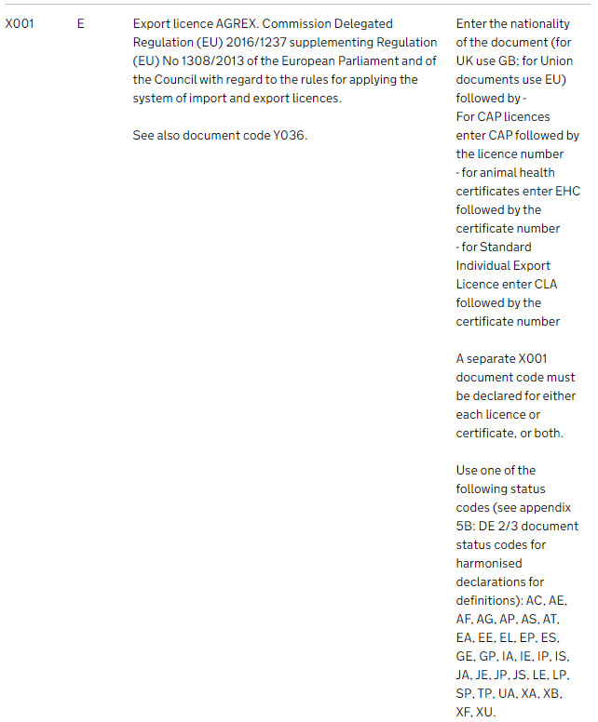
Resolving The Issue
The Error Message is: Relation error: The combination of elements is not allowed.
The pointers point to:
  The Document Code on the 2nd goods item (D.E. 2/3).
  The Document Status Code on the 2nd goods item (D.E. 2/3).
D.E. 2/3 on the second goods item was completed as follows:
  The 2nd Document Code on this declaration is: “X001”
  The 2nd Document Identifier on this declaration is : “AAA11111111A”
  The 2nd Document Status Code on this declaration is: “RE”
Looking at the guidance on the Paper Tariff:
The Paper Tariff confirms that Document Status Code “RE” is not a valid Document Status Code for Document Code “X001”.
To resolve this issue, we can use one of the allowed Document Status Codes for Document Code “X001”.
Protective Marking - <EXTERNAL> |
18
14/01/2020 |

Slide 19
Thank You
Protective Marking - <EXTERNAL> |
19
14/01/2020 |

